Slide 1
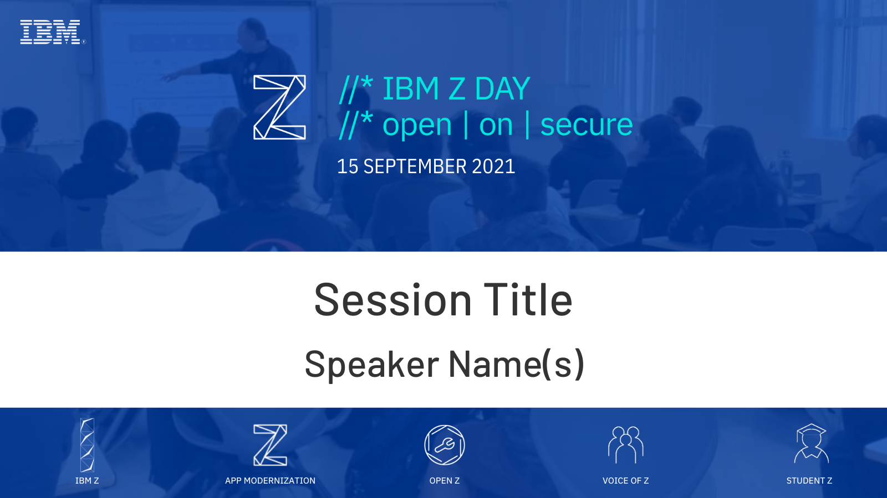
Looking for Open Source Software on Z? Meet the Software Discovery Tool!
Divya Goswami & Elizabeth K. Joseph

Slide 2
A Little About Divya
┬─[divya at racharch in ~/a/t/IBM_Z_DAY]
╰──> λ whoami
I’m Divya, a senior computer student, Lfx Summer Mentee at Open Mainframe Project, Z Ambassador for the year 2021. Currently, I am working in DevSecOps Intern at Trell.
┬─[divya at racharch in ~/a/t/IBM_Z_DAY]
╰──> λ cat important_links
Find me on Twitter: @rachejazz
Find me on Github: @rachejazz
About me: rachejazz.me
About me in free time: rachejazz.me/blogs.html

Slide 3
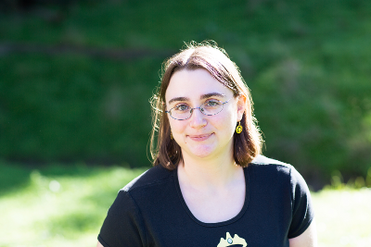
A little about Elizabeth
elizabeth@ibm-z-day:~$ Developer Advocate for IBM Z, Linux Systems Administrator
elizabeth@ibm-z-day:~$ Author of books on Ubuntu and OpenStack
elizabeth@ibm-z-day:~$ Find me on Twitter @pleia2!

Slide 4

Ever wonder what open source packages are available for your operating system on Z?
The search is on!
bit.ly/SDT-main bit.ly/SDT-data
bit.ly/SDT-main | bit.ly/SDT-data

Slide 5

But first, the search criteria
z/OS or Linux?
  If z/OS, are you looking for something in USS?
  What distribution of Linux?
    What version of that distribution of Linux?
    IBM Z vs. s390x vs. System Z vs. zArchitecture…
      (hint: they’re all the same, but projects refer to IBM Z in different ways!)
Fully open source? Enterprise edition?
Vendor or community supported?
Ok, now we can search!
bit.ly/SDT-main | bit.ly/SDT-data

Slide 6

Search!
Software website
  Software “About” page for version available
  Documentation
  Downloads page
Linux distribution package search page
Package Distro Search (PDS)
Online search
Ask your vendor
bit.ly/SDT-main | bit.ly/SDT-data

Slide 7

Meet the Software Discovery Tool!
The Open Mainframe Project’s Software Discovery Tool helps match practitioners with the best open source software that meets their needs.
You can search through open source software for zArchitecture/s390x for any Z operating system from any source, any repo, anywhere, in one place.
https://www.openmainframeproject.org/projects/software-discovery-tool
bit.ly/SDT-main | bit.ly/SDT-data

Slide 8

How did you come up with this idea?
Package Distro Search Tool from IBM already maintains an IBM Z (s390x) search tool for:
Ubuntu
Red Hat Enterprise Linux
SUSE Linux Enterprise Server
SUSE Package Hub
Uses JSON files stored in GitHub as a storage back-end for package data.
PDS: https://ibm.biz/LoZPackageDistroSearch
PDS source: https://github.com/linux-on-ibm-z/PDS
bit.ly/SDT-main bit.ly/SDT-data
bit.ly/SDT-main | bit.ly/SDT-data

Slide 9
How different is the Software Discovery Tool?
Also,
IBM z/OS supported packages!
description for each package (if supported by source file)
Debian 10 and 11
OpenSUSE Tumbleweed and Leap 15.3
Fedora 34
ClefOS 7 from Sine Nomine
And…..?
YOU can help us!
bit.ly/SDT-main bit.ly/SDT-data
bit.ly/SDT-main | bit.ly/SDT-data

Slide 10
Basic Design And What To Expect
Simple easy navigable UI
Options to filter through different operating systems
Optional description column for the confused individuals
Further filtering based on exact versions
Writing a script? We have an API to get you covered!
Few crashes. But that’s OK.
bit.ly/SDT-main bit.ly/SDT-data
bit.ly/SDT-main | bit.ly/SDT-data

Slide 11
I’d Like to Host It Myself!
Have you got CI/CD?
OMP is taking too long to update the sources. May I?
bit.ly/SDT-deploy
YES!
Script that will be auto update your config to support sources from PDS
Delete previous cache and reload server with new sources
Updating every source with every new push
YES YES!
./bin/package_build.py does all the updating
bit.ly/SDT-main bit.ly/SDT-data
bit.ly/SDT-main | bit.ly/SDT-data

Slide 12
Demo
What SDT is capable of doing till date
bit.ly/SDT-main bit.ly/SDT-data
bit.ly/SDT-main | bit.ly/SDT-data

Slide 13
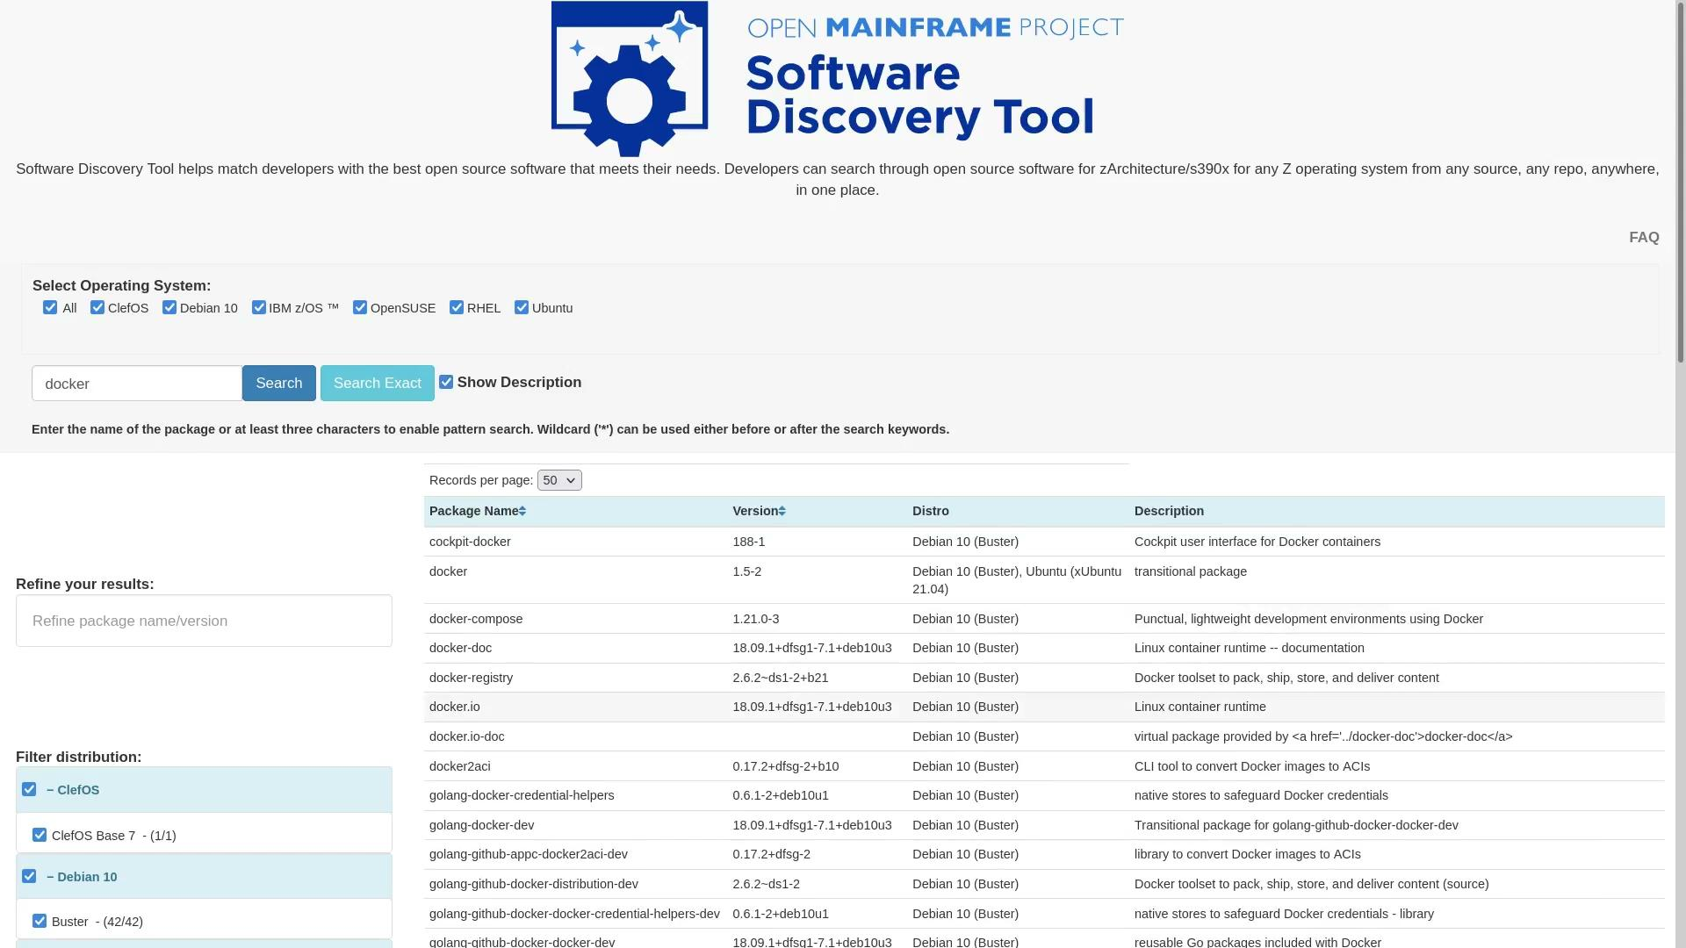

Slide 14
We Need Your Help
Skills
Python
Flask framework
HTML & CSS
User Interface / design
Documentation
Or just curiosity, we can guide the way!
Do not find your software on the list?
Have a new operating system to add?
Other ideas for the tool?
The Z community could use your help!
Learn more in this blog post:
bit.ly/HelpUsZ
bit.ly/SDT-main bit.ly/SDT-data
bit.ly/SDT-main | bit.ly/SDT-data

Slide 15
